Slide 1
Comparing Fast Food Restaurant Density to Median Household Income
Group 5
Michael Battaglia, Sarah Gearardo, Deep Ghosh,
Julie Magro, Melissa Nondorf

Slide 2
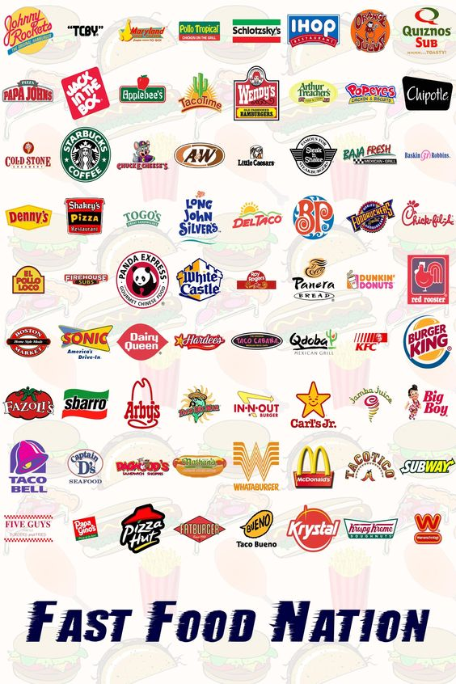

Our Hypothesis
H₀: There is no relation between the density of fast food restaurants and median household income
H_{a}: There is a correlation between the density of fast food restaurants and median household income
Significance level: α = 0.10
Notes:
In the US, fast food restaurants are generally thought of as "cheap food" and are often associated with low-income areas. We wanted to use a machine learning linear regression analysis to investigate if there was a correlation between median income and density of fast food restaurants by zip code.
Why by zip code? We chose it because it’s a convenient pseudo-geographic designation that appears in both datasets.
According to the US Census Bureau, Zip codes are not physically- or politically-defined features but a collection of mail delivery routes. In other words, the only thing that distinguishes one zip code from another is the post office that services that area.
H₀: There is no relation between the density of fast food restaurants and median household income
H_{a}: There is a correlation between the density of fast food restaurants and median household income

Slide 3

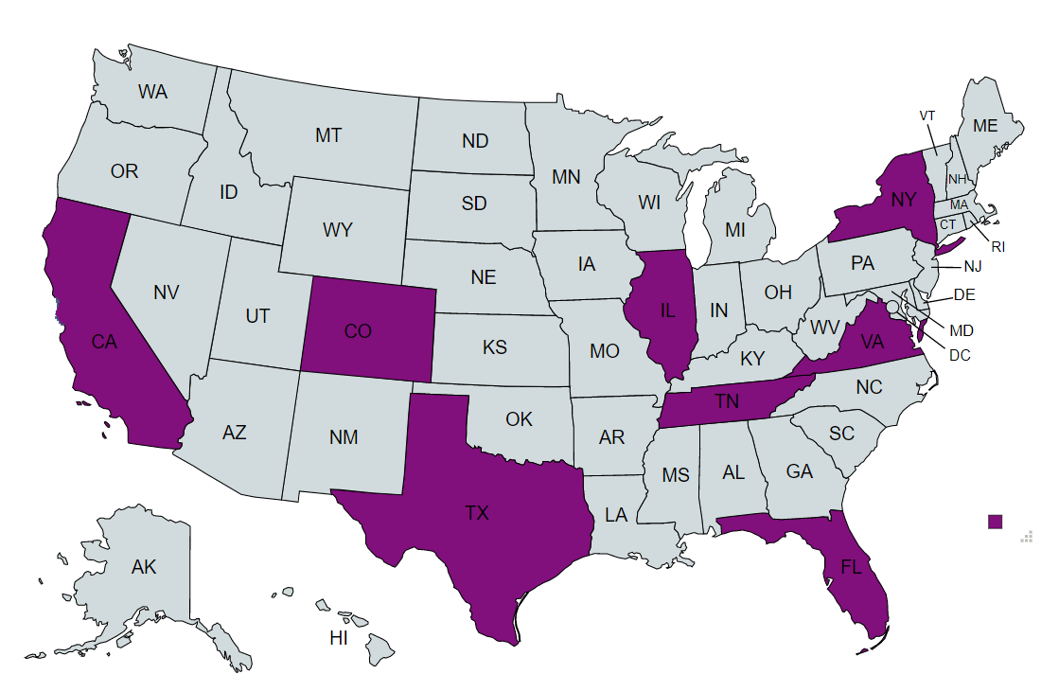

Data
Census Data on US Household Income Statistics for 2011-2015
Restaurant locations scraped from Yelp
Notes:
Census Data on US Household Income Statistics for 2011-2015
Restaurant locations scraped from Yelp
After several false starts with the Yelp API, much frustration, and consultation with the teaching team, we decided to use a subset of eight states (CA, CO, FL, IL, NY, TN, TX, and VA) to run our analysis on in order to keep the scope of the project manageable. The selection of states was arbitrary but we did attempt to choose places that we hoped were fairly representative of the US as whole.

Slide 4

Much like Edison’s quote, our project felt like 1% analysis and 99% ETL.
Notes:
Find data sources and agree on a topic and hypotheses - easy
Extract data: easy for HHI, difficult for Yelp API (not user-friendly)
Transform data: seemed easy but ended up having to go back and make additional changes multiple times
Load: Easiest of the three parts

Slide 5


Household Income Data
Began with: 32,526 rows and 19 columns
Dropped unwanted columns, duplicate zip codes, null values, removed DC and PR, formatted zip codes to have leading zeros
Left with: 14,664 rows and 6 columns
Yelp API Results
Started off with: 27,606 results in individual state files
“Globbed” the 8 csv files together: 27,458 results*
Dropped duplicates: 13,248 results
Notes:
HHI Data
Pretty straight forward
Began with: 32,526 rows and 19 columns
Dropped unwanted columns, duplicate zip codes, null values, removed DC and PR, formatted zip codes to have leading zeros
Left with: 14,664 rows and 6 columns
Yelp API
Not so straight forward
After failing to convince Yelp to return results for a single set of data for those 14k zip codes, we reduced it to 27,606, which it still consistently returned errors for, despite having a stated limit of 5k individual API calls a day. Eventually, we had to break the zips down into individual state files and run each separately, and divide both Texas and California into two parts because we’d return errors if any zip code file had more than 1k entries.
Started off with: 27,606 results in individual state files
“Globbed” the 8 csv files together: 27,458 results*
Dropped duplicates: 13,248 results because Yelp’s required use of a radius resulted in significant duplication of results in some areas.

Slide 6
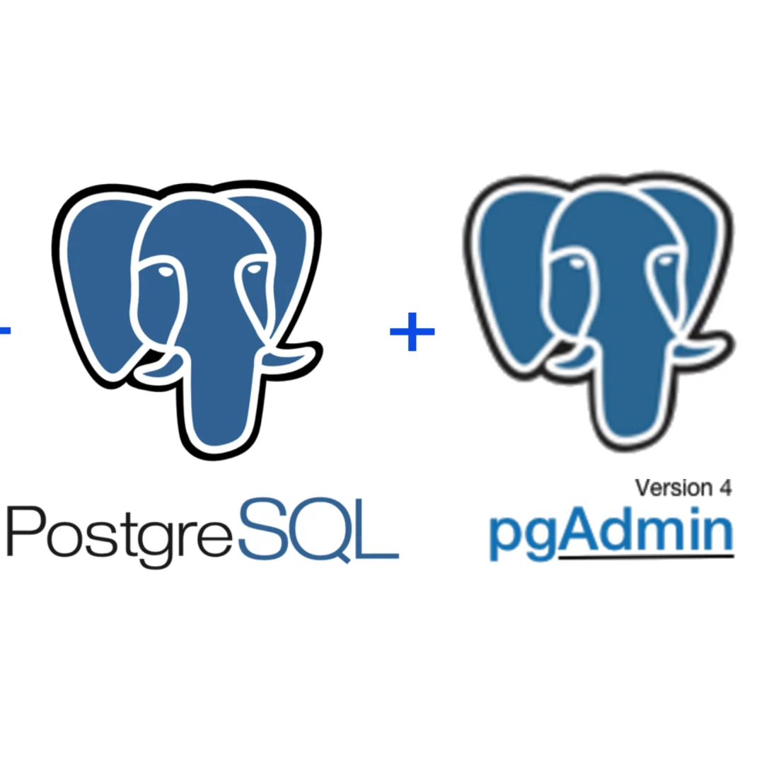


Ready to load and analyze, right? WRONG
Notes:
Joined the Yelp and HH Income tables together and dropped the address, latitude, and longitude columns because they were no longer needed.
We originally performed a FULL JOIN on the data in an attempt to retain all information from both files. In deciding which of the two zip code columns to drop, though, we discovered that the the HH Income file included 1,164 rows with null values for zip code. Since we were very intentional about dropping all null values during initial cleaning of that dataset, we assume that this must indicate that some restaurants were located in non-residential zip code areas that would not appear in the HH Income dataset. We changed our join from FULL to INNER to remove these null values, which further reduced our dataset to 12,084.

Slide 7
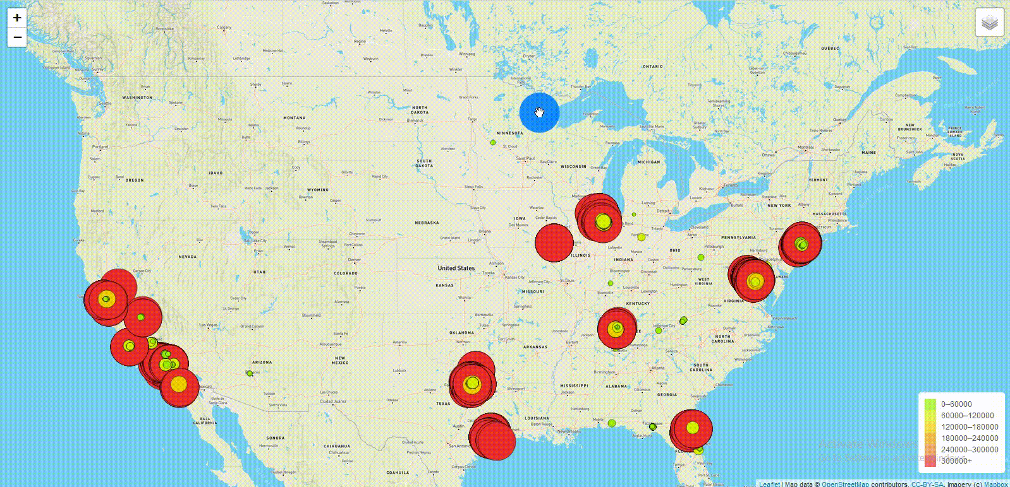
Notes:
Maps Placeholder

Slide 8

Analysis
Round 1: simple linear regression with all 12,804 data points
Round 2: simple linear regression, removing the cluster of results at the $300k limit
Round 3: multiple linear regression with all 12,804 data points but only using data for the top 5 most popular “types” of fast food restaurant
Notes:
Deep
Round 1: simple linear regression with all 12,804 data points
Round 2: simple linear regression, removing the cluster of results at the $300k limit
Round 3: multiple linear regression with all 12,804 data points but only using data for the top 5 most popular “types” of fast food restaurant
Audience participation time: Can anyone guess what the most common type of food returned from the Yelp API scrape? Hotdogs!
✓ Description of data preprocessing
✓ Description of feature engineering and the feature selection, including their decision-making process
✓ Description of how data was split into training and testing sets- 75% training and 25% testing
✓ Explanation of model choice, including limitations and benefits
✓ Explanation of changes in model choice (if changes occurred between the Segment 2 and Segment 3 deliverables)
✓ Description of how they have trained the model thus far, and any additional training that will take place

Slide 9
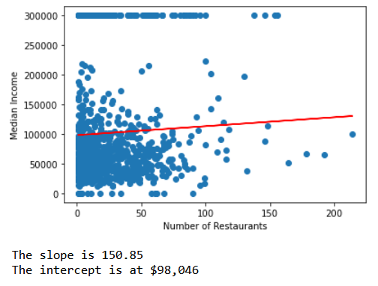
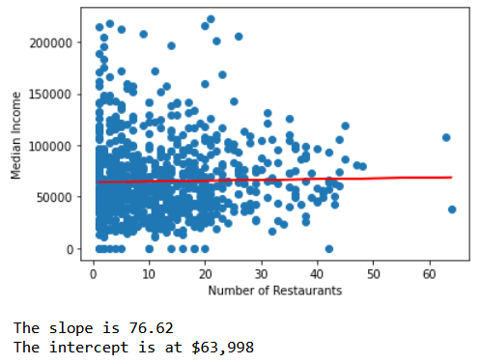
Results
Notes:
Deep
The initial analysis showed a weak positive correlation between our independent variable - density of fast food restaurants - and our dependent variable - median income.
Because the correlation was so weak, we decided to run the numbers are few more times with further adjustments to the data to see if those changes made any difference.
Removing the potential outliers of extremely high median incomes clustered at the $300k line resulted in an even weaker slope/ correlation

Slide 10
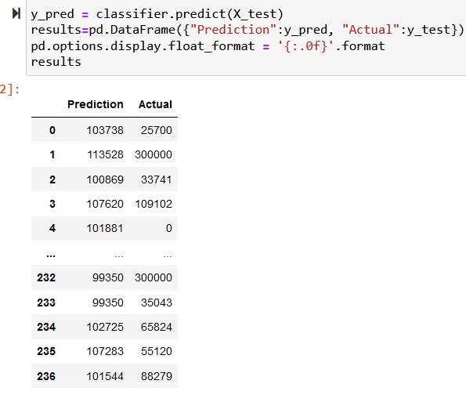
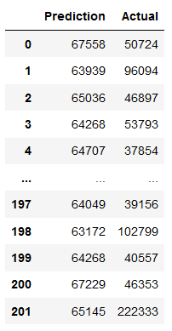
Notes:
Deep

Slide 11
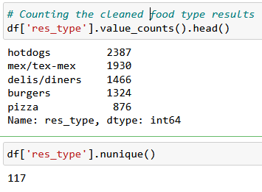
Parsing out the Most Popular Types of Fast Food
Notes:
After doing some cleaning, there were 117 unique food types in the Yelp results.
These were the top five most popular in order: Hotdogs, Mexican, Delis, Burgers, and Pizza

Slide 12
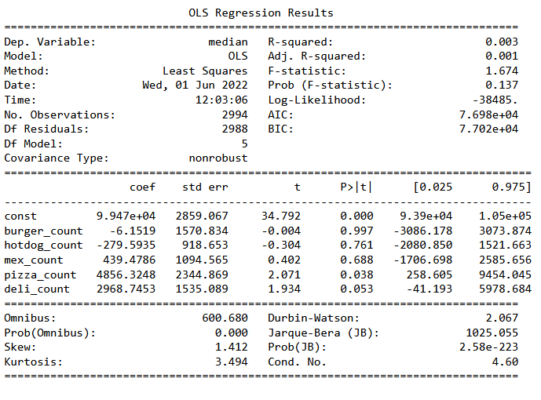
Median Household Income = 10050 - 6.15 burger_count - 279.59 hotdog_count + 439.48 mex_count + 4856.32 pizza_count + 2968.75 deli_count
Notes:
Julie
The simple linear regressions gently proved our alternative hypothesis
MLR showed significance in the pizza_counts and deli_counts at the alpha = 0.10 level
10% significance level means we have a 10% chance of false positive results
This significance indicates that we reject the null hypothesis and assume that there is a relationship between density of pizza restaurants and income, as well as deli restaurant density and median household income in a zip code
Since there is a positive coefficient for both pizza_count and deli_count, this implies that as you increase pizza restaurant density or deli restaurant density individually, the median household income for a zip code also increases

Slide 13
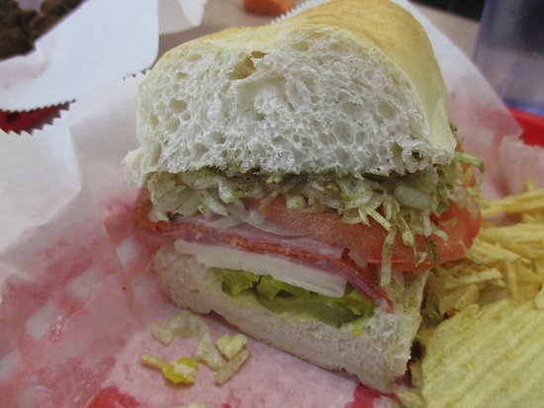

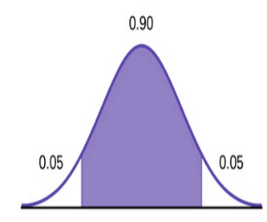
Model Analysis
Benefits of our Chosen Models
Able to analyze multiple restaurant types individually
Simple to understand variables (positive slope = higher income)
Limitations
More forgiving alpha level = Higher false positive rate
Simple Linear Regression was not enough
Only 5 Restaurant types
Linear variables, not categorical
Notes:
Julie - Analysis of our models (not study as a whole)
Pizza & deli - most predictive of the restaurants (Also the lowest count of the top 5)

Slide 14


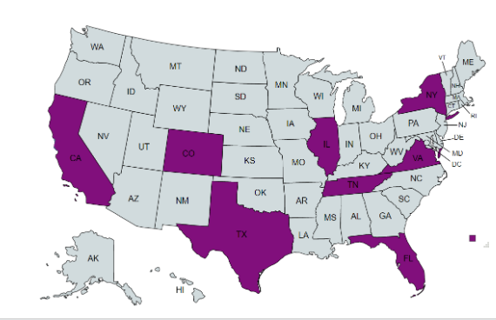

Overall Study Analysis
Data time frame?
Unexplained data loss in the ETL process
State selection process
Yelp search radius selection process
What counts as “fast food”?
Notes:
Julie
Discrepancy in time frame of data capture
HHI is from 2011-2015 but the Yelp results are ostensibly current, as of last month
Unexplained data loss in the ETL process
148 data points were dropped when we “globbed” the 8 csv files with Yelp results together in Pandas. Tiny fraction of the data but does it affect the results?
Only 8 states
Are the eight states we randomly selected representative of the country as a whole?
Was our Yelp search radius appropriate for both rural and urban areas?
Per Ben’s advice, we only searched a 5k meter radius for each zip code, which is approximately 3 miles.
What counts as “fast food” and what doesn’t?
[See following slide for details]

Slide 15
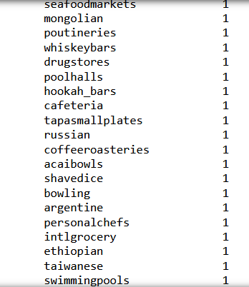
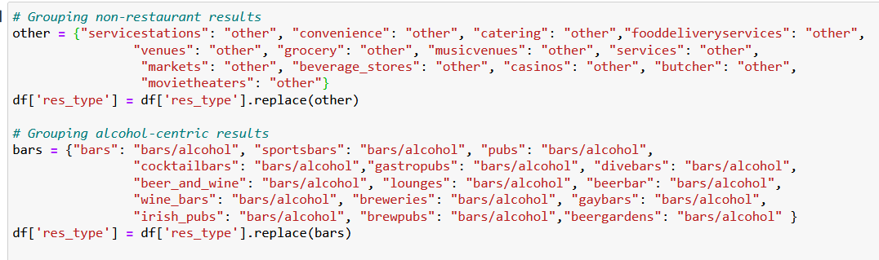
Notes:
Julie - random categories of restaurants (thanks Yelp)

Slide 16

Conclusion
It appears that you are a little bit “what you eat”, at least when it comes to the median income in your area and the fast food restaurants near you.
Future studies should focus on pizzeria density and deli restaurant density significance to more accurately predict median household income.
Notes:
Which is probably a good thing….

Slide 17
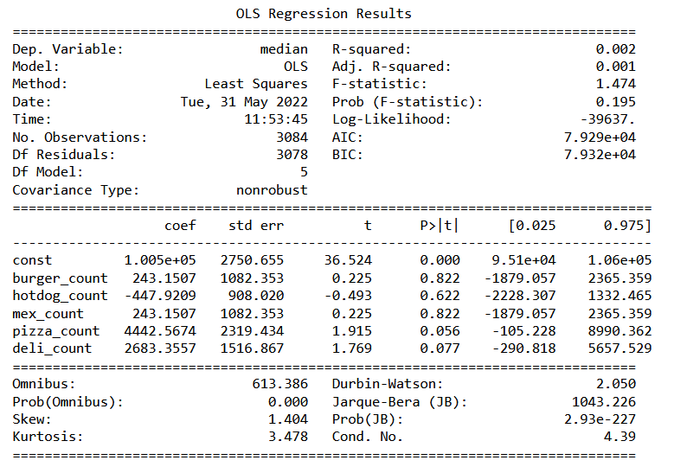
Median Household Income = 10050 + 243.15 burger_count - 447.92 hotdog_count + 243.15 mex_count + 4442.57 pizza_count + 2683.36 deli_count
Notes:
Julie
The simple linear regressions gently proved our alternative hypothesis
MLR showed significance in the pizza_counts and deli_counts at the alpha = 0.10 level
10% significance level means we have a 10% chance of false positive results
This significance indicates that we reject the null hypothesis and assume that there is a relationship between density of pizza restaurants and income, as well as deli restaurant density and median household income in a zip code
Since there is a positive coefficient for both pizza_count and deli_count, this implies that as you increase pizza restaurant density or deli restaurant density individually, the median household income for a zip code also increases

